Slide 1
“Rss Feed Reader”
A project by:
Akaash V (cse14002)
Rishi Mathur (cse14038)
Vyas giridharan (cse14060)

Slide 2
Problem Statement
To create a software with a graphical user interface that collects data from the user’s favorite websites and displays it as a feed thus removing the need for manually checking the website for new content.

Slide 3
Objective
To use the concepts of OOPS to create a RSS feed reader that collects the RSS feeds from the user’s choice of websites and display it .

Slide 4
NEED
RSS feeds also benefit users who want to receive timely updates from favorite websites or to aggregate data from many sites.
Subscribing to a website RSS removes the need for the user to manually check the website for new content. Instead, this software constantly monitors the site and informs the user of any updates.

Slide 5
Problems we wish to overcome
Currently there are no RSS feed readers in the Linux Operating system.
We wish to overcome that by doing this project.

Slide 6
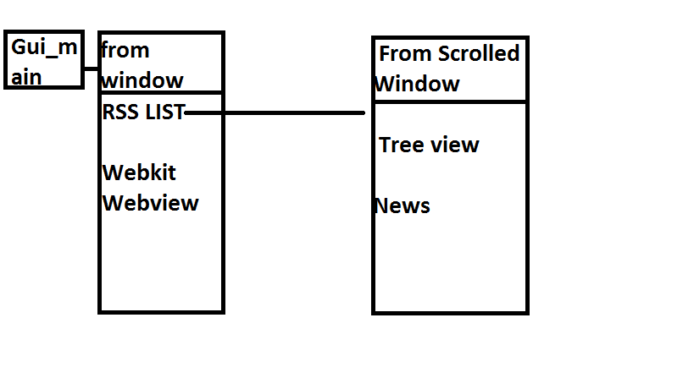
ARCHITECtural diagram

Slide 7
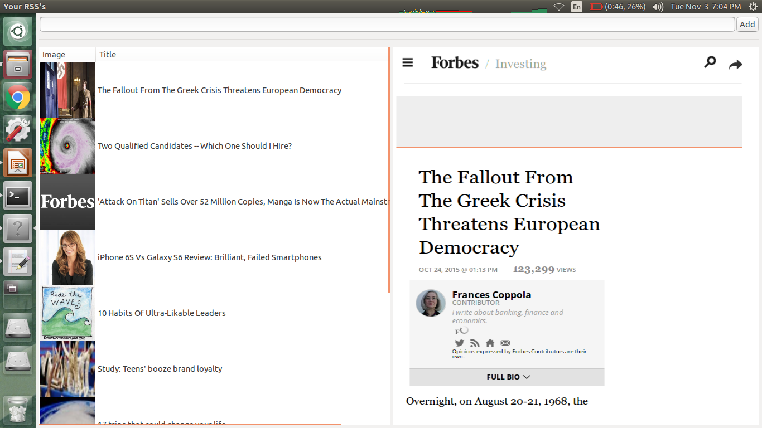
OUTPUT screenshots

Slide 8
FUTURE enhancement
A thread can be started in the background that will automatically search for changes in the news feed.

Slide 9
REFERENCES
https://developer.gnome.org/gtkmm/
http://www.cplusplus.com/reference/future/async/
https://pypi.python.org/pypi/feedparser
https://www.stackoverflow.com/

